Slide 1


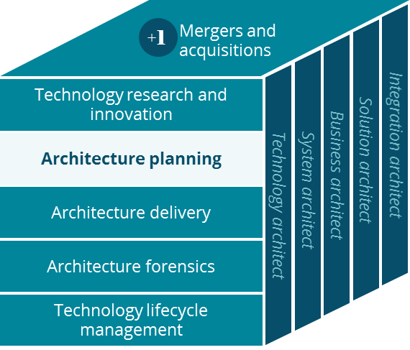
Journey to Hybrid Cloud
Architecture Planning
Lala Liu
March 2019

Slide 2


Executive Summary
The Hybrid Cloud Strategy must provide ‘freedom of choice’ across cloud and on-premise services, stimulating innovation and accelerating transformation of healthcare
Opportunity
Conclusions
Recommendations
Modern cloud environments provide flexible ways to leverage pre-built capabilities in an on-demand fashion
When done right, cloud strategies enable enterprises to innovate faster and reduce opportunity cost
Developers want to use easily consumable cloud services for innovation and experimentation
Modern infrastructure teams are looking for simple and affordable ways to enable and delivery business results
No single cloud provider will have all the services needed to accelerate the CVS Health transformation of healthcare
It is critically important to have freedom of choice across all available services, whether cloud hosted or on-premise
Connected Health requires a cohesive approach to integrating all cloud and on-premise services across the company
Cloud-legacy-applications are a tangible risk in an environment that allows building of cloud solutions without integration into the broader CVS Health ecosystem
Adopt a hybrid cloud strategy based on all mission critical and business critical assets being hybrid cloud connected
Invest in an omni-cloud Hybrid Cloud Control Plane to ensure robust security and operational stability, apply to all leveraged cloud environments
Stand up support and enablement functions to accelerate the CVS Health journey to hybrid cloud, whether through migrating existing assets or through building brand new hybrid cloud solutions

Slide 3

Business Opportunity
The Journey to Hybrid Cloud will accelerate innovation, help deliver Connected Health, and position CVS Health to effectively combine existing and new (cloud) technologies
Opportunity Statement
Overview
Development
With a cohesive approach to Hybrid Cloud we can leverage innovative technologies and capabilities, and combine them with existing assets to quickly assemble new solutions
Operations
With investments in a hybrid cloud control plane we can manage security and operational robustness across an omni-cloud environment
Consumer Experience
By pursuing a path of making everything Hybrid Cloud Connected we can provide a connected and responsive experience regardless of deployment location and hosting model for the underlying IT assets
In order to accelerate the CVS Health transformation, we need freedom of choice in how we bring technology to bear on business problems and opportunities

Slide 4
Why is it important to CVS Health?
Having the ability to test and learn fast, to combine existing and new assets in innovative solutions, is at the heart of delivering Connected Health to all Americans
What CVS Health could gain…
Potential Benefit
Description
Positive Outcomes
Rapidly test and learn
Freely combine existing and new assets
Integrate the Health Ecosystem
Test and learn without needing to worry about provisioning, security, network or infrastructure platform
Freely and easily combine existing and new IT assets, whether on-premise or cloud hosted
Integrate the Health Ecosystem through a unified approach to identity, network connections and API based integration
Faster innovation and development cycles
Reduced cost and complexity
A Connected Health outcome

Slide 5



How Hybrid Cloud fits into the overall Tech Strategy?
Multiple interdependent technology strategies to accelerate the creation of a Connected Health ecosystem, fulfilling our promise to the people we serve
Ecosystem Integration
API Strategy
Connected Health
High degree of cohesion and interoperability
Global Identity and Digital Accounts
Global Preferences and Permissions
Omni-channel visibility and communication
Built in security and compliance (by design)
Fit for purpose APIs (opportunistic)
Speed time to market
Lower cost of integration
Connect/reuse existing assets
Pattern driven deployment and operation
Easy third party integration
Data Strategy
Hybrid Cloud Strategy
Single source of truth for Insight
Curated, integrated, shared data
Global catalog, semantic inference
Scalable hybrid cloud platform
Seamlessly leverage diversified technologies
Create flexibility, freedom of choice, innovation
Connect new/exist assets, avoid ‘cloud-legacy’
Scale for fast, reliable, automated operations

Slide 6

Where are we today?
Uncoordinated efforts will create growing complexity that if left unchecked results in unmanaged cost, decreased agility, and increased compliance risk
Development
Operations
Consumer Experience
Inconsistent
Approach
Un-coordinated Deployment and Mgmt.
Islands of Assets
Hybrid Cloud Historical State
Inconsistent hybrid cloud practices are creating siloed developer experiences
Disjointed cloud technology adoption resulting in integration complexity
Mismatched levels of maturity in hybrid cloud development and production is causing duplicated investment
Lack of modern integration practices and capabilities are slowing down time to market
Multiple approaches to data access results in inefficient and improper use of information across the company
Multiple paralleled management processes with various degrees of hybrid cloud maturity are creating uncertain quality levels and potential operational instability
Manually driven processes and unmanaged cloud consumption are wasting resources
Unclear total cost of ownership and lack of common hybrid cloud standard are resulting in opaque understanding of benefits and costs
Uncoordinated security standard interpretation and adoption is leading to confusion and compliance risks
Lack of a cohesive ecosystem approach leads to disconnected consumer experience
Isolated systems and assets cause difficulty in accessing data, and ultimately result in lower information quality
Platform specific solutions and the absence of an unified ecosystem strategy prevents full omni-channel understanding of the health consumers needs and desires

Slide 7










Where are we today technology wise?
Heritage CVS Health and Aetna have pursued similar purposes on the Hybrid Cloud Journey, yet develop dissimilar and parallel hybrid cloud platform solutions
Public Cloud SaaS
2
Public Cloud IaaS/PaaS
Public Cloud SaaS
2
Public Cloud PaaS/IaaS
Current State
Solutions
1
Separate and non-integrated hybrid cloud platforms
Different mixes of cloud providers and services
Different software products and approaches to managing cloud services
Internet
Internet
Dedicated Circuits
Dedicated Circuits
Equinix
NetBond
2
3
3
3
1
Private Cloud IaaS/PaaS
Private Cloud IaaS/PaaS

Slide 8
What does Success look like?
CVS Health Hybrid Cloud is the leading technology brand that drives innovation to deliver personalized and Connected Health to consumers
Development
Operations
Consumer Experience
To…
To…
To…
Simplified Adoption
Optimized Operations
Hybrid Cloud Connected Solutions
From…
From…
From…
Inconsistent
Approach
Un-coordinated deployment and Mgmt.
Islands of assets
Where we want to go
Simplified DevSecOps processes that betters developer experiences
Integrated and richer set of tools that allows freedom to choose the best technology for the problem
Disciplined patterns and approaches that improves collaboration and enhances productivity
Advanced hybrid cloud service model and capability adoptions that drives innovation and accelerates time to market
Consistent and data-backed services that leads to personalized, Connected Health
Unified and broadly adopted Control Plane that manages environments and ensures service integrity
Scaled self-service abilities and automated consumption administration that saves time and improves efficiency
Common measurement matrix and clear cost of ownership that delivers operational excellence
Best practices and consistent security standards that mitigates risks
Ubiquitous access to hybrid cloud connected assets and analytics across CVS ecosystem that can easily be shared and leveraged to generate differentiated consumer value
Advanced architecture and unified data fabric that supplies best-in-breed data quality and interoperability
Integrated Data Strategy that unlocks the hidden value and delivers the optimized actionable insights

Slide 9





What does Success look like?
Our Hybrid Cloud ecosystem is fully integrated with freedom to choose the best tools and technologies for a given business solution and simplified DevSecOps processes
HYBRID CLOUD
Unified
Data Fabric
Omni Channel
Interaction
Enterprise
Integration
Platform
Global
ID
Account
For Life
Preferences
HYBRID CLOUD
MANAGEMENT
ACCESS
VULNERABILITY
MANAGEMENT
CI/CD
MONITORING
INVENTORY
INCIDENT,
PROBLEM, CHANGE
REPOSITORY
SYSTEMS
NETWORK
CONNECTIVITY
CONTROL PLANE
On-premises
Private Cloud
Google
Azure
Amazon

Slide 10
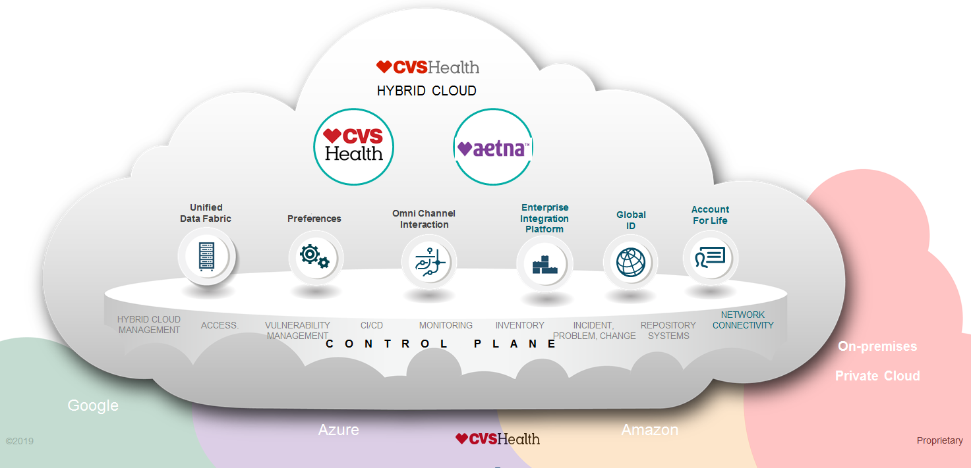
Hybrid Cloud – Avoid Building New ‘Legacy’
Hybrid cloud connected is the minimum bar to meet in order to avoid creating disconnected ‘legacy’ solutions (cloud and on-premise both)
Enabling Connected Health
Hybrid Cloud Managed
Managed by the Hybrid Cloud Control Plane
Also Hybrid Cloud Connected
Hybrid Cloud Connected
Global ID, Account for Life enabled
Plugged into the Hybrid Cloud API Management platform
Leveraging Hybrid Cloud Network
Legacy Solutions
‘Disconnected’
Regardless of cloud characteristics (public, private or on-prem)

Slide 11






On-Premise Assets can be Hybrid Cloud Connected
Regardless of deployment model, on-prem solutions can be Hybrid Cloud Connected to make them first class citizens of the Connected Health Ecosystem
PART OF
HYBRID CLOUD
CONNECTED
Unified
Data Fabric
Preferences
Omni Channel
Interaction
Global
ID
Enterprise
Integration
Platform
Account
For Life
On Prem
Private Cloud
HYBRID CLOUD
MANAGEMENT
ACCESS
VULNERABILITY
MANAGEMENT
CI/CD
MONITORING
INVENTORY
INCIDENT,
PROBLEM, CHANGE
REPOSITORY
SYSTEMS
NETWORK
CONNECTIVITY
CONTROL PLANE
Google
Azure
Amazon

Slide 12

Cloud / SaaS Assets can be Hybrid Cloud Connected
Public Cloud and SaaS solutions can be Hybrid Cloud Connected to make them first class citizens of the Connected Health Ecosystem
PART OF
HYBRID CLOUD
External Service
Clouds
CONNECTED
Unified
Data Fabric
Preferences
Omni Channel
Interaction
Enterprise
Integration
Platform
Global
ID
Account
For Life
HYBRID CLOUD
MANAGEMENT
ACCESS.
VULNERABILITY
MANAGEMENT
CI/CD
MONITORING
INVENTORY
INCIDENT,
PROBLEM, CHANGE
REPOSITORY
SYSTEMS
NETWORK
CONNECTIVITY
CONTROL PLANE
On-premise
Private Cloud
Google
Azure
Amazon

Slide 13


New Cloud Solutions add to ‘Legacy’ if not Connected
Assets that are not Hybrid Cloud Connected add to our ‘legacy baggage’
X
PART OF
HYBRID CLOUD
Disconnected
Native Cloud
Solution
‘Cloud-legacy’ Assets
‘Legacy’ is not about AGE
but rather the ability to fully
participate in our ecosystem
Unified
Data Fabric
Preferences
Omni Channel
Interaction
Enterprise
Integration
Platform
Global
ID
Account
For Life
HYBRID CLOUD
MANAGEMENT
ACCESS.
VULNERABILITY
MANAGEMENT
CI/CD
MONITORING
INVENTORY
INCIDENT,
PROBLEM, CHANGE
REPOSITORY
SYSTEMS
NETWORK
CONNECTIVITY
CONTROL PLANE
‘On Prem’ Legacy Assets
Google
Azure
Amazon

Slide 14
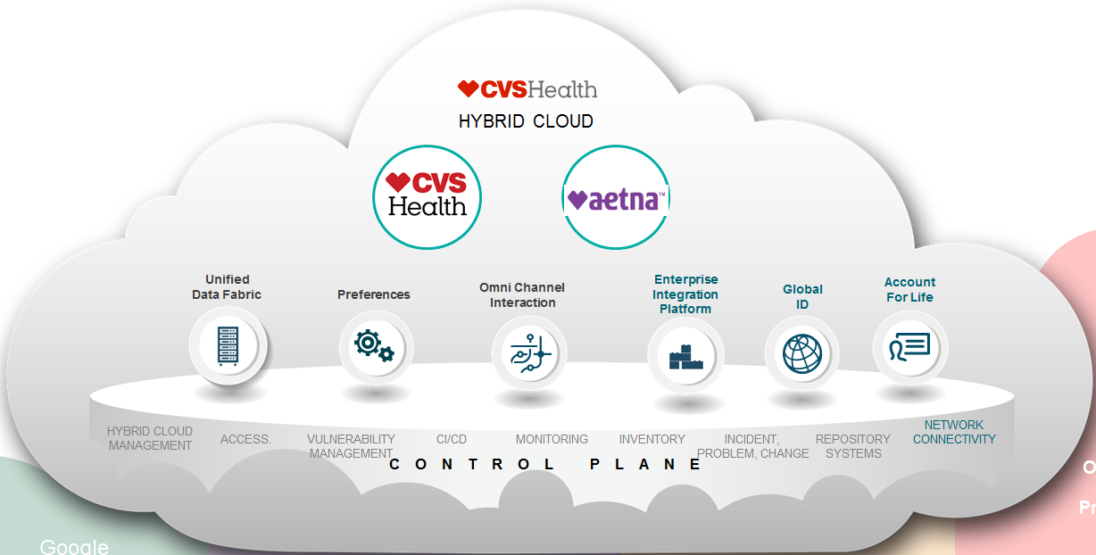


Recommended Investments
Strategic investments and coordinated efforts are critical to the success of the CVS Health Journey to Hybrid Cloud
Recommended Initiatives
Continue to invest in our omni-cloud Hybrid Cloud Control Plane
Invest in hybrid cloud expansion of the ecosystem components, and ensure that all mission critical and business critical assets are at a minimum hybrid cloud connected
Stand up support and enablement functions to accelerate our Journey to Hybrid Cloud whether through harnessing existing assets or building brand new cloud solutions
1
3
2
3
2
3
1

Slide 15
Next Steps
Connect everything – Manage Everything – Change the Mindset
Recommendations
Immediate
Mid-Term
Long-Term
Avoid building any more ‘cloud legacy solutions’, make all new solution at a minimum Hybrid Cloud Connected
Create a single Hybrid Cloud API Management platform (underway as part of the integration program)
Create a single Global ID capability (underway as part of the integration program)
Create a single Hybrid Cloud Network backbone
Invest in making all existing mission and business critical assets Hybrid Cloud Connected
Expand the Hybrid Cloud Control plane to all cloud environments leveraged by CVS Health
Centralize the Hybrid Cloud service inventory and global catalog
Assess workload placement and cost, automate workload distribution
Enable developer self-service
Establish a ‘hybrid cloud first’ mind set
Fully integrate the Hybrid Cloud Control Plane with localized DevSecOps tools and processes
Form a vibrant Hybrid Cloud community to accelerate adoption, harvest best practices and promote change
Optimize total cost of ownership for existing and new IT assets
Continuously monitor industry advancement, evolve the strategy and improve our Hybrid Cloud services

Slide 16

What We Need to Excel
CVS Health has a tremendous opportunity to transform and lead the healthcare technology space through execution of a robust Hybrid Cloud strategy
We believe a successful hybrid cloud strategy will enable us to deliver much more connected, flexible, effective and innovative solutions than our competitors, retain better operational and compliance controls, deliver freedom of choice to developers, and ultimately deliver a richer set of healthcare services. This will lead us to be the technology pioneer in healthcare.
Connected
Strategy
Coordinated
Effort
Cloud-enabled Architecture
Advanced
Management
Compete for Excellence
Align Approach
Build Talent
Standardize Patterns
Centralize management
Accelerate Innovation
Unify Integration
Optimize Capabilities
Make Flexible by Design
Adopt Control Plane
Embrace Collaboration
Leverage Technology
Synergize Investment
Containerize Everything
Deliver an Omni-Cloud
Exploit Opportunities
Connect Assets
Form Community
Make Secure and Agile
Balance Workload
Optimize Services

Slide 18


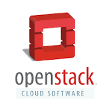
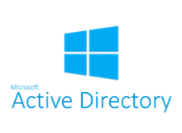



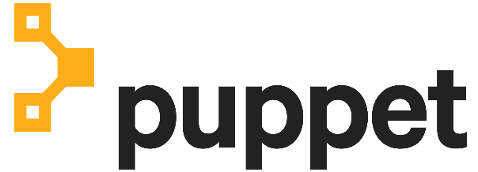













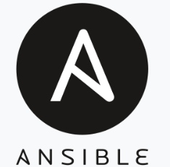





CVSH Hybrid Cloud Control Plane
Access
Consistent provisioning of user accounts in cloud providers
Hybrid Cloud Management
Self-service delivery for deploying, automating and managing multi-cloud environments
Vulnerability Management
Cyclical practice of identifying, classifying, remediating, and mitigating vulnerabilities
Repository Services
Centralized source code management
Network
Standardize core to cloud connectivity with reputable service provider (Equinix)
Incident, Problem, Change
Extend existing process to include cloud activity
Monitoring
Extend existing tooling to cloud accounts or leverage new products to fill gaps
Inventory
Ingest cloud assets into our existing CMDB
CI/CD Pipeline
Accelerating the SDLC through DevOps automation and testing

Slide 19
Enterprise Cloud Strategy: Control Plane Mapping
Control Plane Category | Maps To | GS Control
Access |  | Identity & Access Management, Data Security, Data Loss Prevention
Hybrid Cloud Management |  | Infrastructure As Code, Data Security, Data Loss Prevention
Vulnerability |  | IT Hygiene
Repository |  | *ALL 25 Controls
Network |  | Network Security
Incident, Problem, Change |  | Security Event Logging/Incident Response
Monitoring |  | Security Event Logging/Incident Response
Inventory |  | IT Hygiene

Slide 20
Necessary Action (1 of 2)
Hybrid Cloud Connect new and existing assets, drive freedom of choice to mash up hybrid capabilities in creating Connected Health
Capability Area
In Scope
Necessary Actions
Make core assets in the traditional data center environment the first class citizens of the CVS Hybrid Cloud
Leverage cloud native patterns for all new product and programs development
Hybrid Cloud
Connected Assets
Hybrid Cloud Connect
All Existing Assets
Make New Assets
Hybrid Cloud Connected
IT Operations
Leverage Capability
Expand and leverage capabilities and compute models to provide flexible services that cross infrastructure, platform, container, function and data
Centralize service inventory and use a global catalog to register and share hybrid cloud assets and services
Enable centralized service consumption monitoring, transparent resource provisioning
Global Catalog
Manage Consumption

Slide 21
Necessary Action (2 of 2)
An optimized CVS Health Hybrid Cloud requires integration across the enterprise
Capability Area
In Scope
Necessary Actions
Enforce adoption of Global Identity and Account for Life across all constituents
Implement customer Preference to engage consistent and compliant personalization
Enable Omni Channel interaction to deliver connected experience
Build out and unify Hybrid Cloud API management on a single platform
Ecosystem
& Integration
Global Identity
Preferences
Account for Life
Omni Channel
API Management Platform
Infrastructure
& Management
Platform
Network Backbone
Strengthen and promote network backbone for all hybrid cloud connections
Enhance Hybrid Cloud Control Plane management capabilities, promote unified adoption
Hybrid Cloud Control Plane

